Slide 1

Navigating the Education System
Laura Caird, BBCS

Slide 2

What is the difference between a SRT, a SERT, an IEP, a BSP and an IPRC?

Slide 3
What is a SRT?
A School Resource Team (SRT)
A SRT meeting is a meeting between school staff. This school resource team is usually comprised of the principal, the teacher, the special education resource teacher (SERT) and at times, the educational assistant (EA).
Services available at the board level, such as the ABA consultant, the speech and language pathologist (SLP), and psychometrist or psycho-educational consultant can be asked to join the school resource team.
The goal of an SRT could be to prepare for an Identification, Placement and Review Committee (IPRC), or to discuss the purchase of equipment through a special equipment amount (SEA) claim.

Slide 4
Who is a SERT?
The Special Education Resource Teacher (SERT) offers many services to staff and students, which may include:
supporting students with special learning needs
providing resources/strategies to staff and students
facilitating the use of Ministry Laptops and associated assistive software
formal testing for identification purposes
ongoing assessments to monitor student progress
facilitating direct instruction on a one-to-one basis or in small groups
coordinating the referral process to access the area team and outside agencies
developing Individual Education Plans (IEP) in conjunction with classroom teachers
acting as a liaison to Special Education classes

Slide 5
What is an IEP?
An Individual Education Plan (IEP) is a written plan describing the special education program and/or services required by a student.
An IEP includes:
a statement of the child’s exceptionality
a statement of the child’s Special Education placement
a list of the child’s learning strengths and needs
an outline of services and/or equipment that will be received
a list of accommodated, modified or alternative expectations
non-identified IEPs include accommodations only
a list of documentation upon which the IEP is based
outline of curriculum and alternative expectations for the student
a plan for macro-transitions
★ An IEP is a working document and at any time throughout the school year parents
may contact the Special Education department to review the IEP and its contents.

Slide 6
What is the difference between an accommodation and a modification?
Accommodations change how a student learns the material.
These changes do not alter the provincial expectations for the grade.
Accommodations help students learn the same material and meet the same expectations as their classmates (i.e. preferential seating, extra time on tests, audio recording of text, spell-check on computer, etc.)
Modifications change what a student is taught or expected to learn.
These changes may be at a different grade level or a decrease in the number or complexity of the regular grade-level curriculum expectations.
Students who are far behind their peers may need changes, or modifications, to the curriculum (i.e. assigned shorter or easier assignments, testing may require a student to cover less material or material that is less complex, student may work at a different grade level, etc.)

Slide 7
3 Categories of Accommodations
Instructional: adjustments in teaching strategies required to enable the student to learn and to progress through the curriculum.
Examples: Extra time for processing information
Oral and written instructions
Photocopies of notes
Environmental: changes or supports in the physical environment of the classroom and/or school.
Examples: Preferential seating
Alternative work location
Assessment: assessment adjustments in assessment activities and methods required to enable the student to demonstrate learning.
Examples: Additional time
Use of a calculator
Use of a computer and/or assistive technology

Slide 8
What is an Alternative Expectation?
Alternative expectations support a student’s development in areas that are not directly linked to the Ontario curriculum.
Alternative Expectations Alternative Expectations may be aligned with the “Learning Skills and Work Habits” section of the Report Card.
Responsibility
Organization
Independent work
Collaboration
Initiative
Self-regulation
Alternative Expectations may not be linked directly to the Ontario Curriculum and are therefore, assessed on the Alternative Report Card.
Social Skills
Fine Motor Skills
Gross Motor Skills
Daily Living Skills
Behaviour Management

Slide 9
Transition Plans
The transition plan must include the following elements:
specific goals for the student's transition to postsecondary activities (goals must be realistic and must reflect the strengths, needs and interests of the student)
the actions required, now and in the future, to achieve the stated goals (actions identified must build on the student's identified strengths, needs, and interests)
the person or agency (the student, parents, educators, providers of specialized support and services, community agencies) responsible for or involved in completing or providing assistance in the completion of each of the identified actions
timelines for the implementation of each of the identified actions
long-range cumulative plan for transition (school-to-school, grade-to-grade) documents the actions, person or people responsible for the action and the timeline
collaborative involvement of student, parent(s), school and community partners

Slide 10
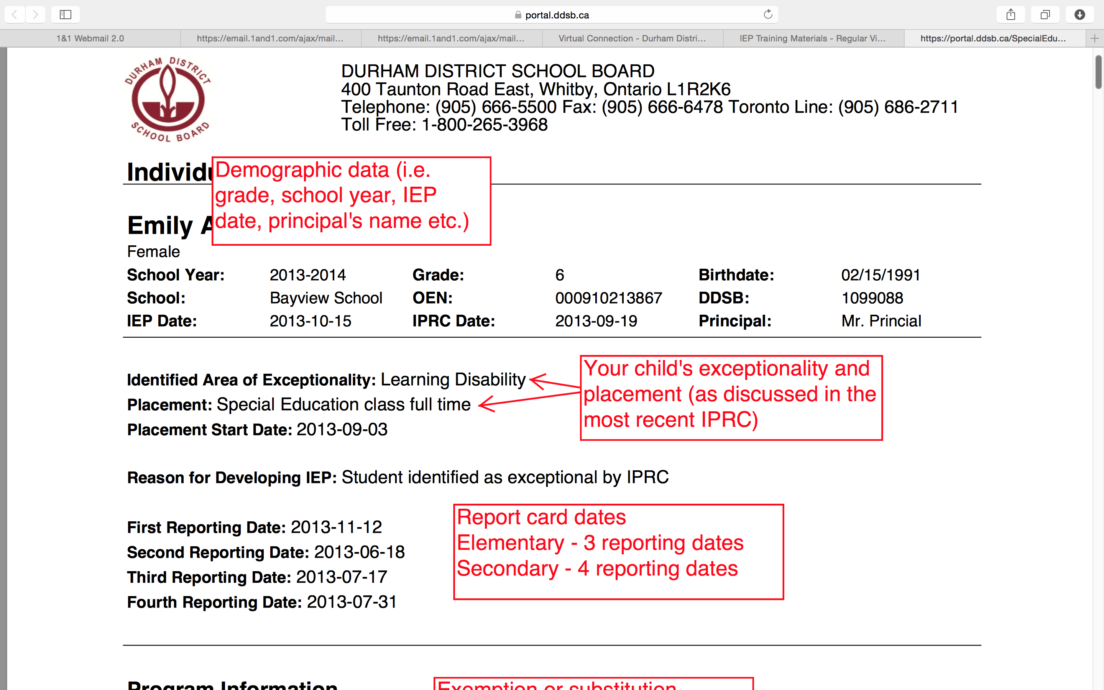
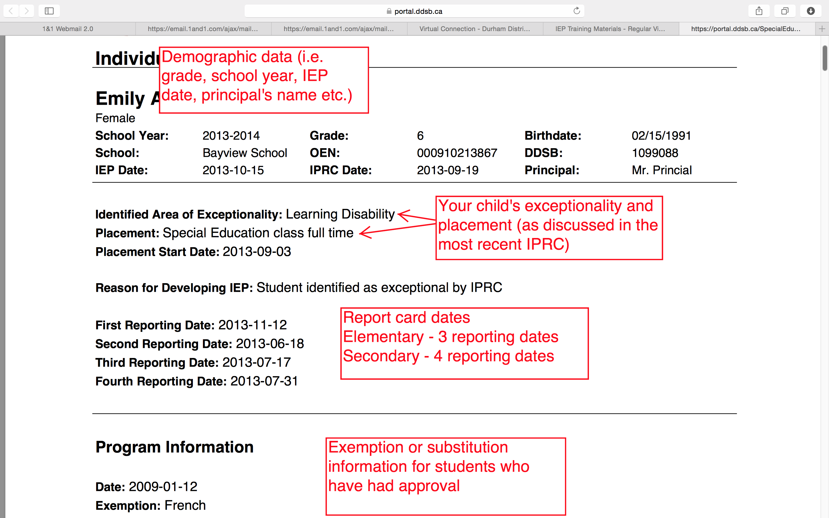
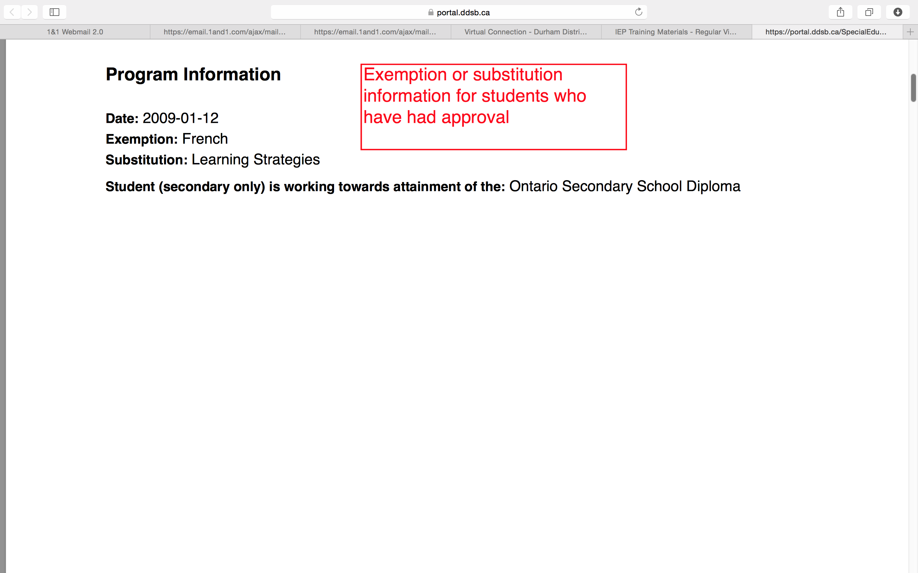
Sample IEP

Slide 11
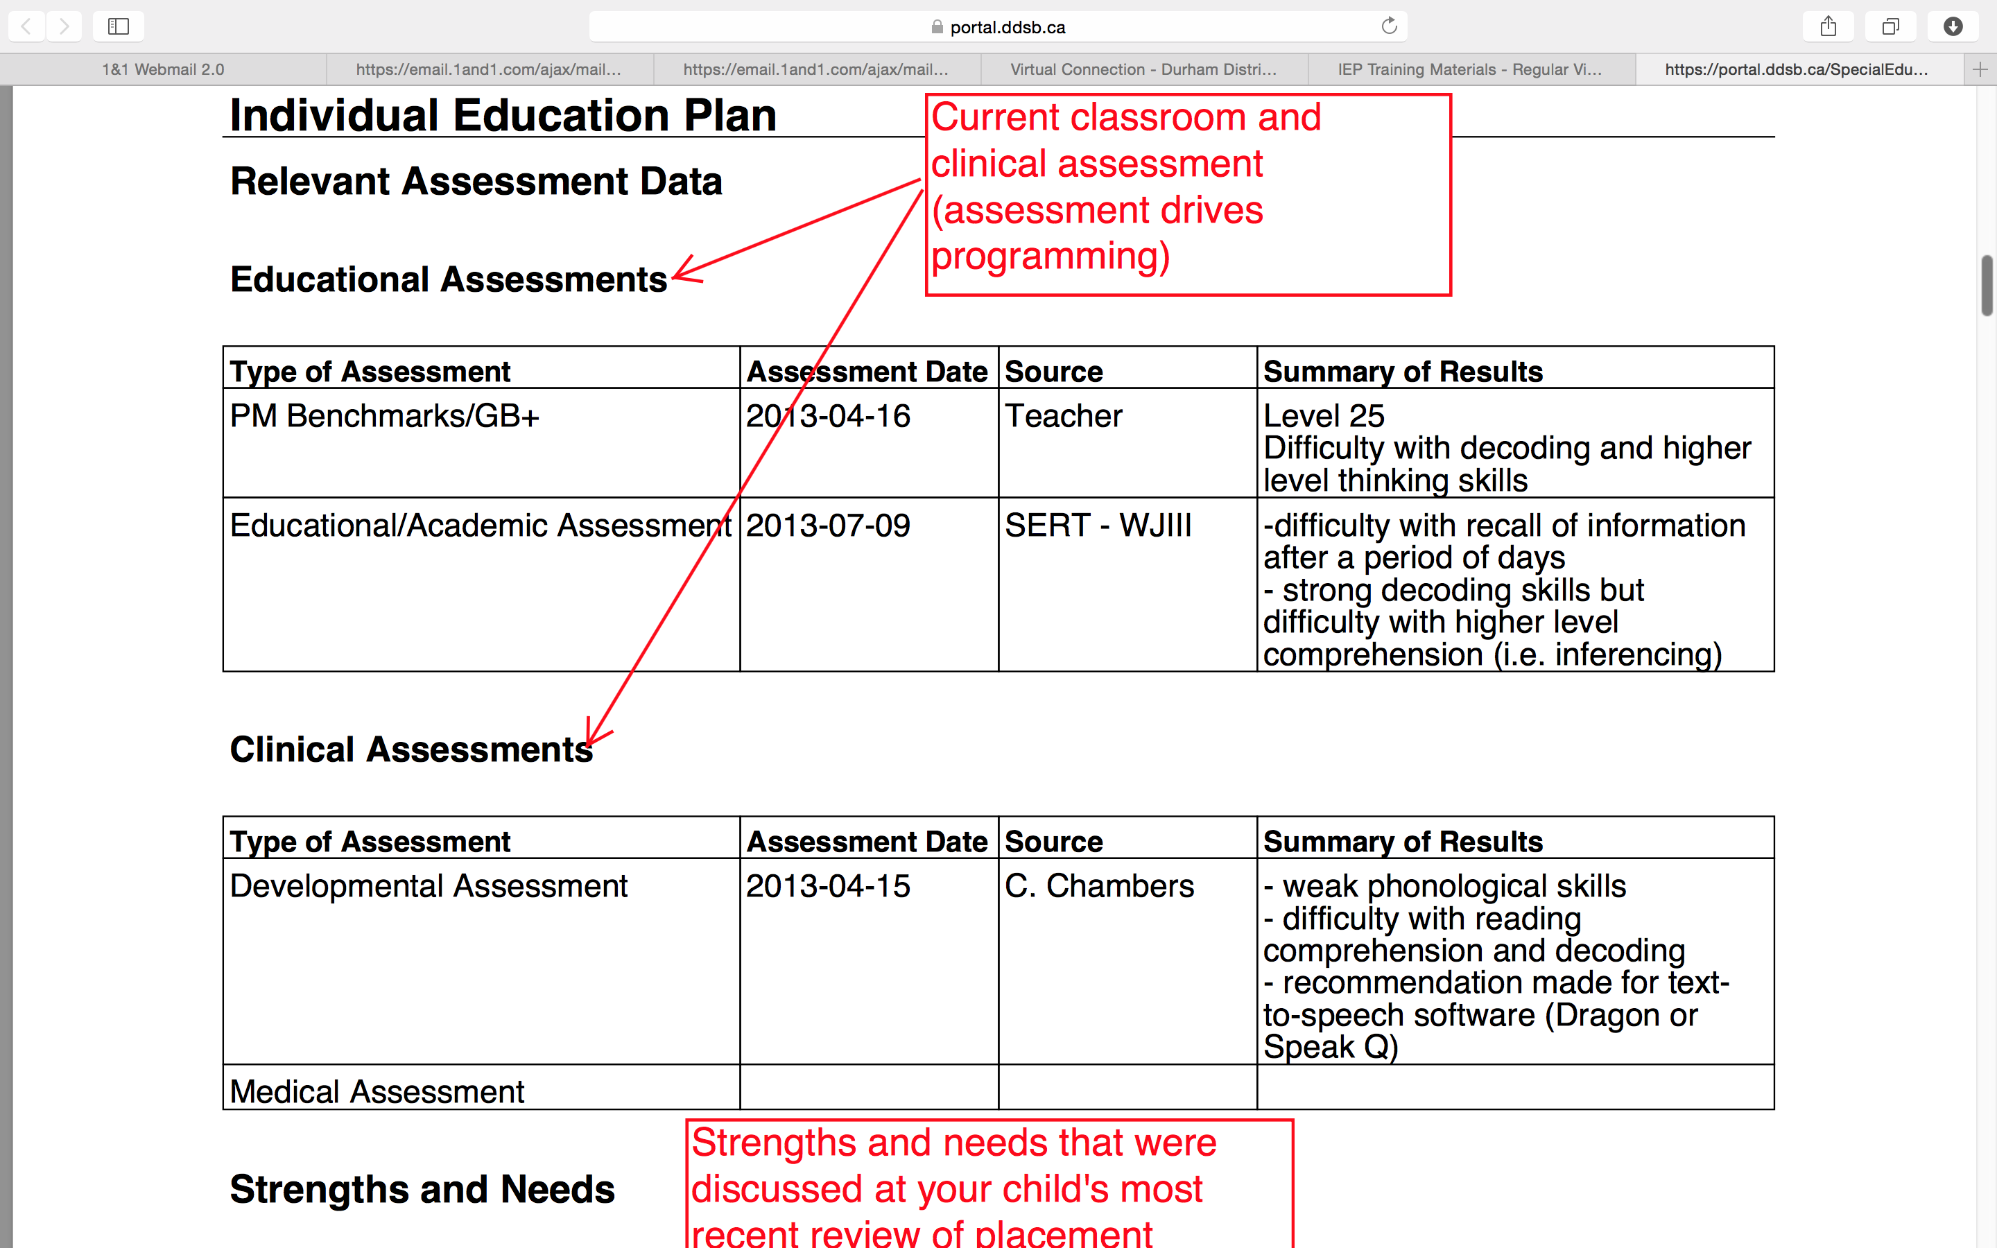
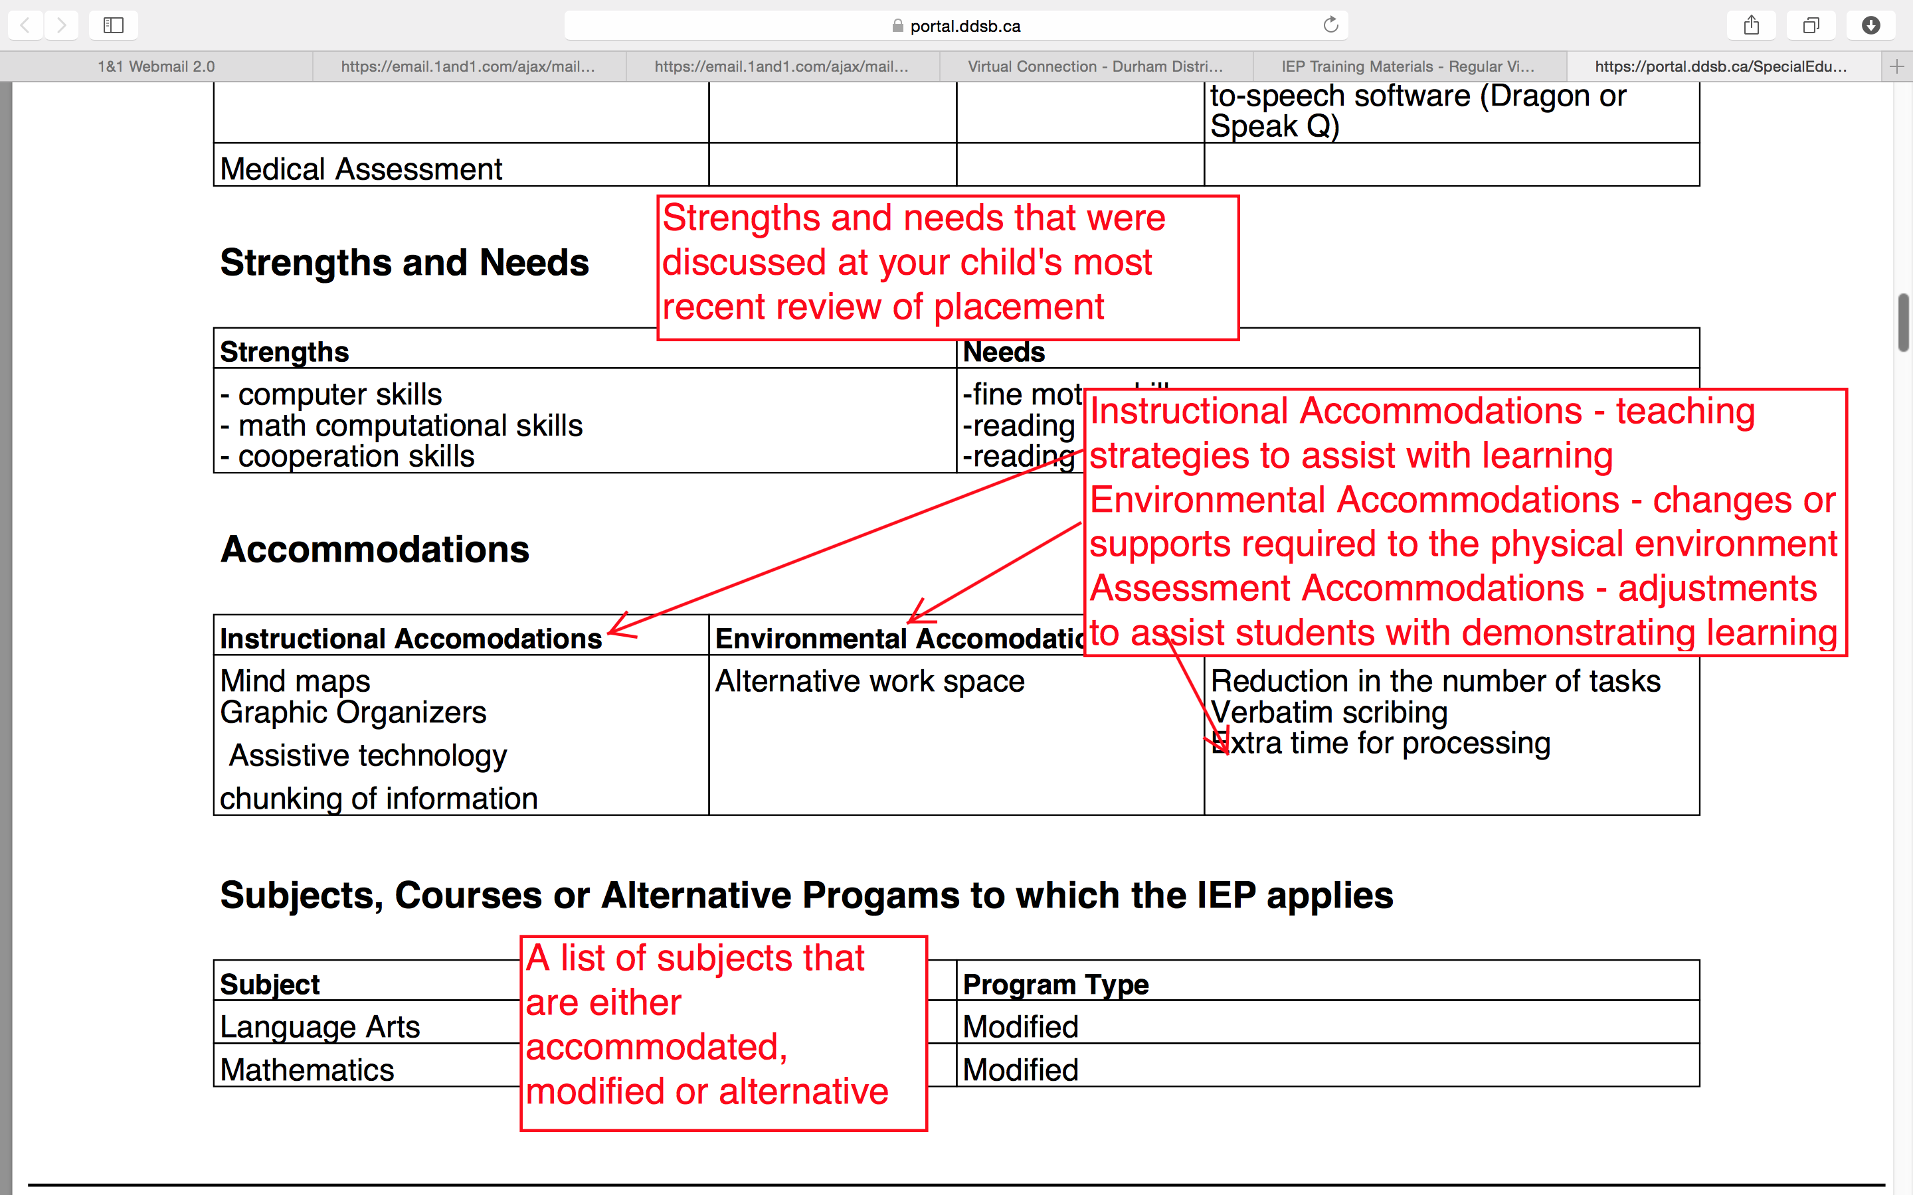

Slide 12
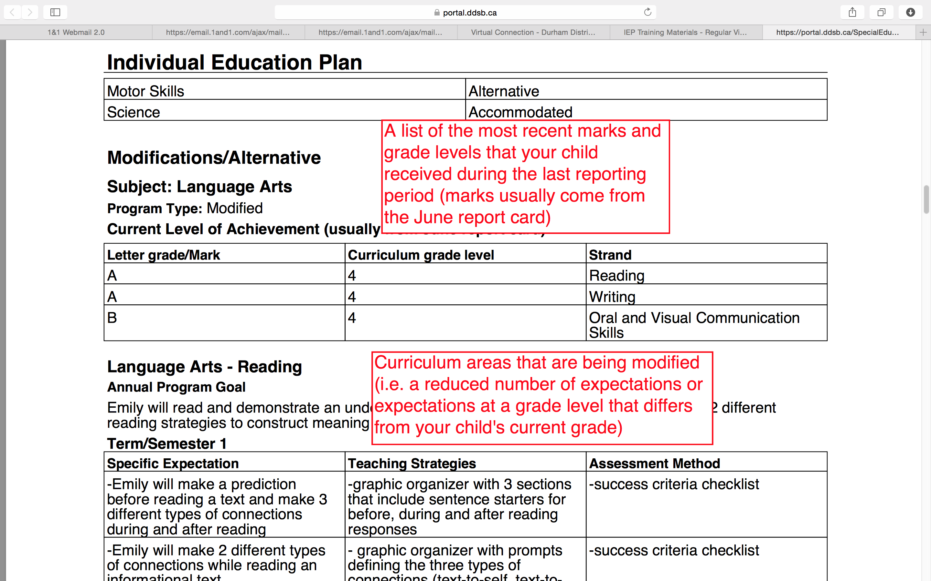
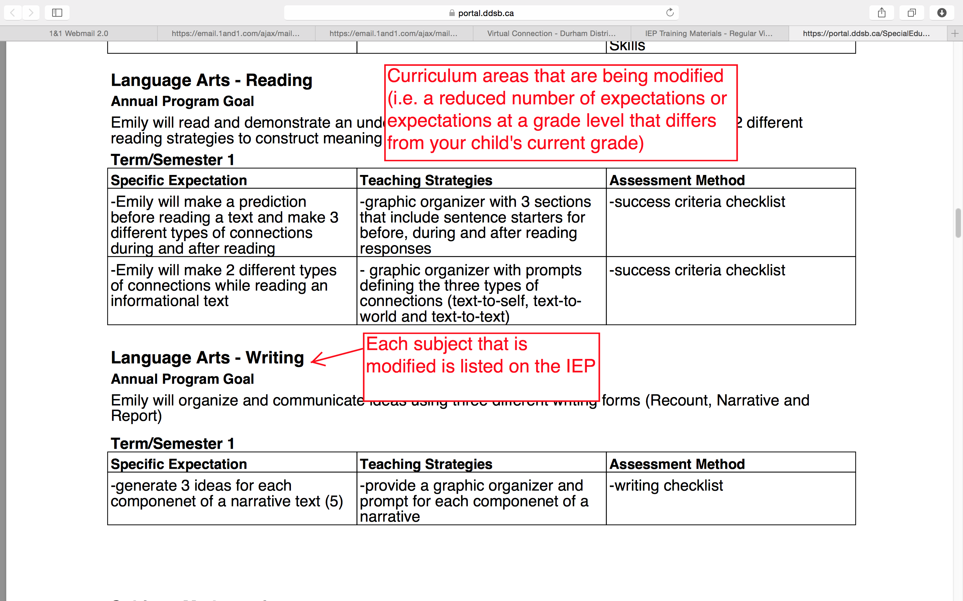

Slide 13
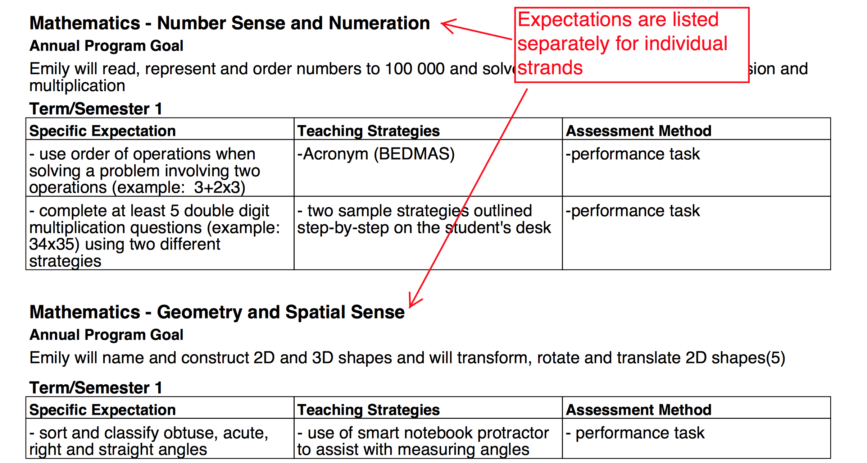

Slide 14
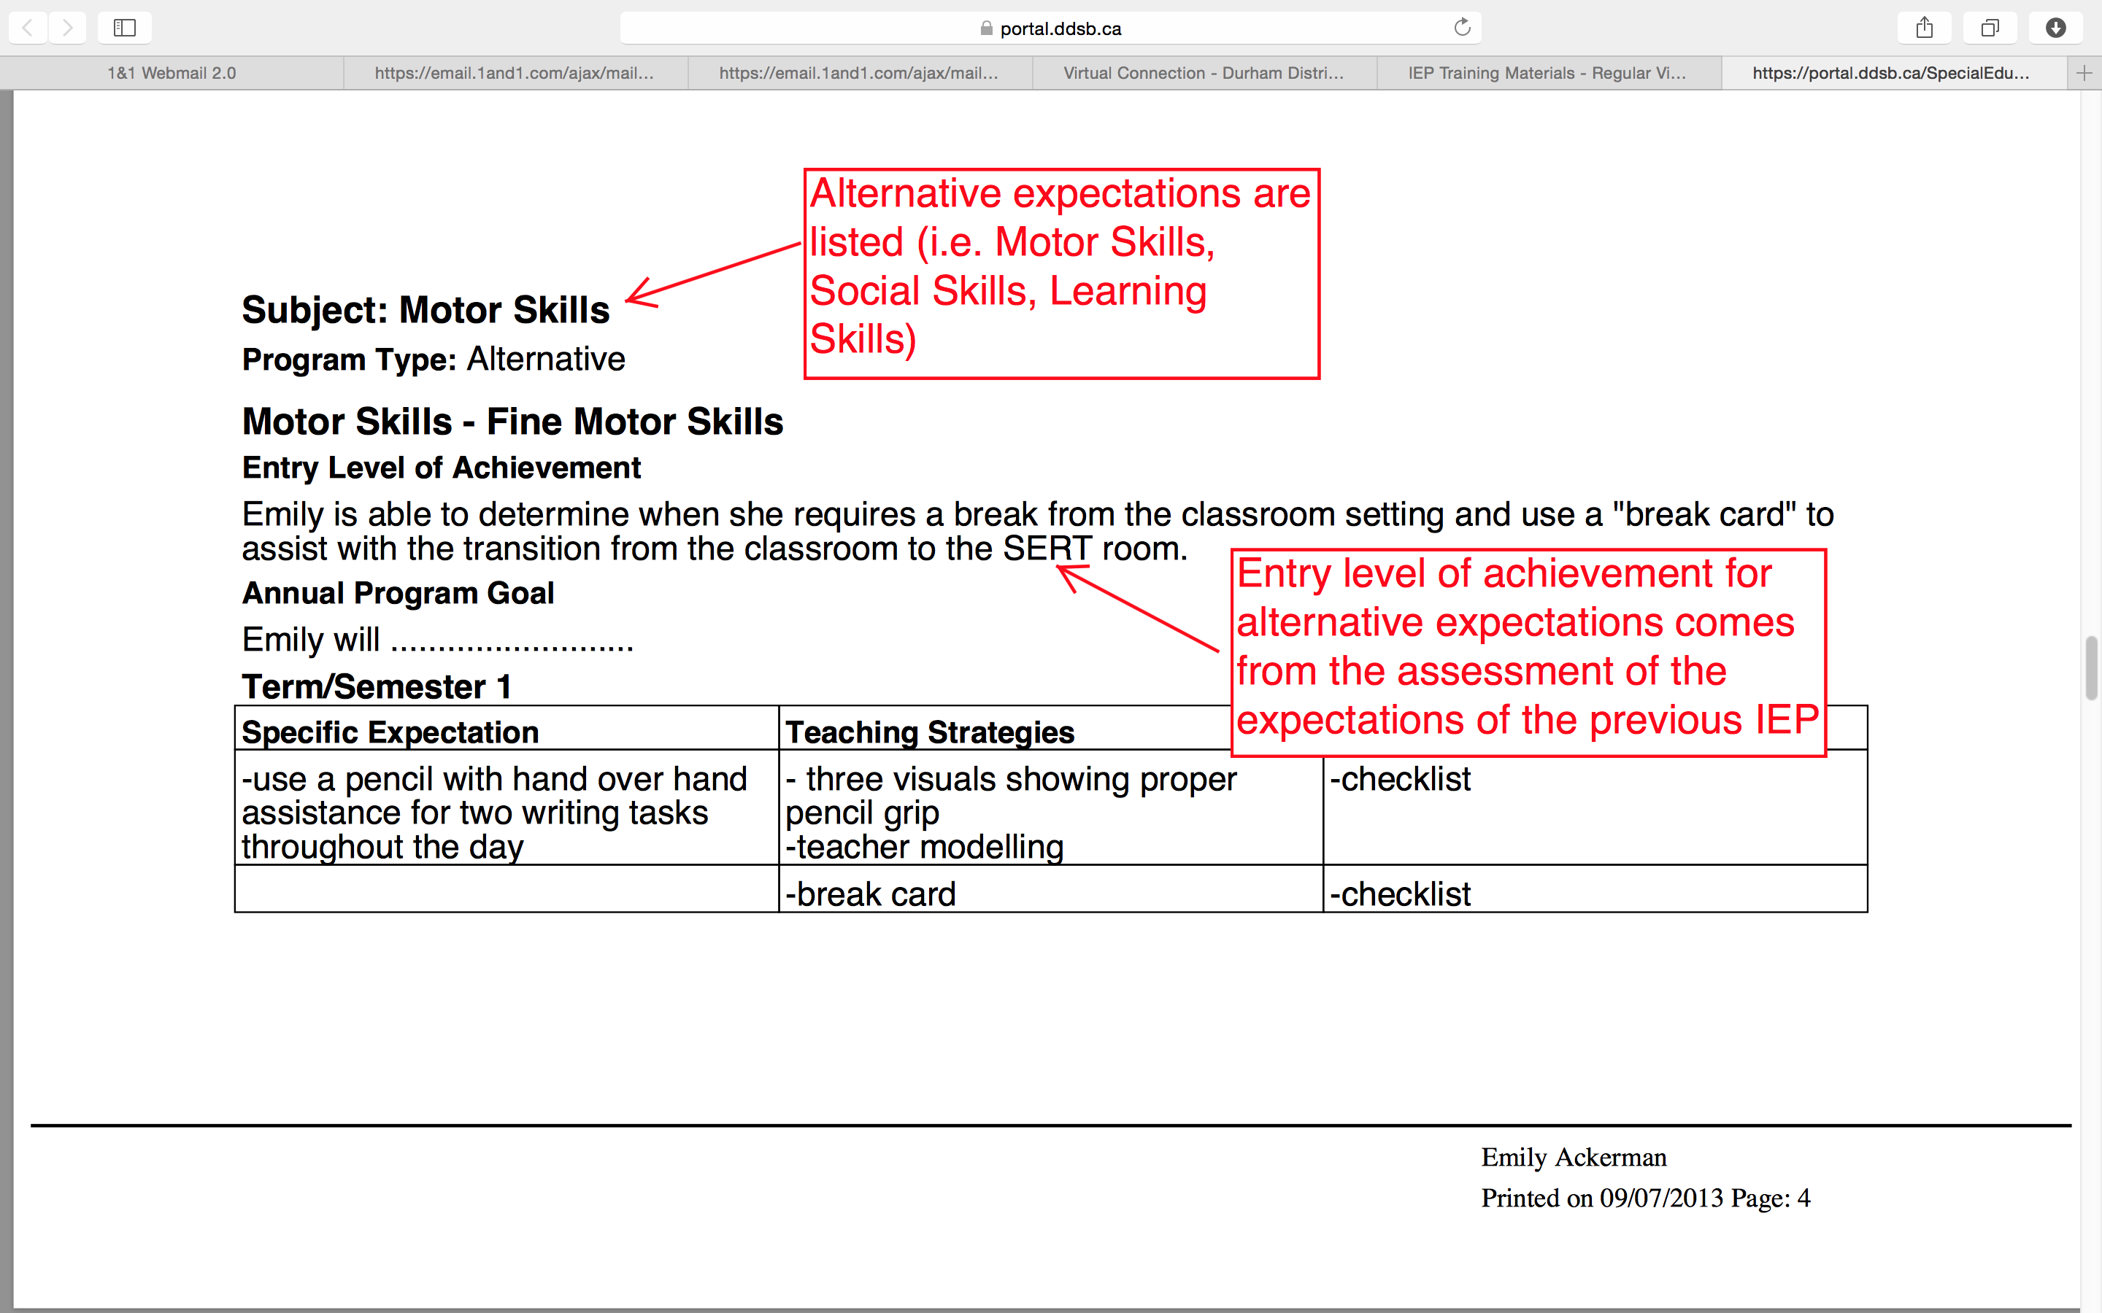
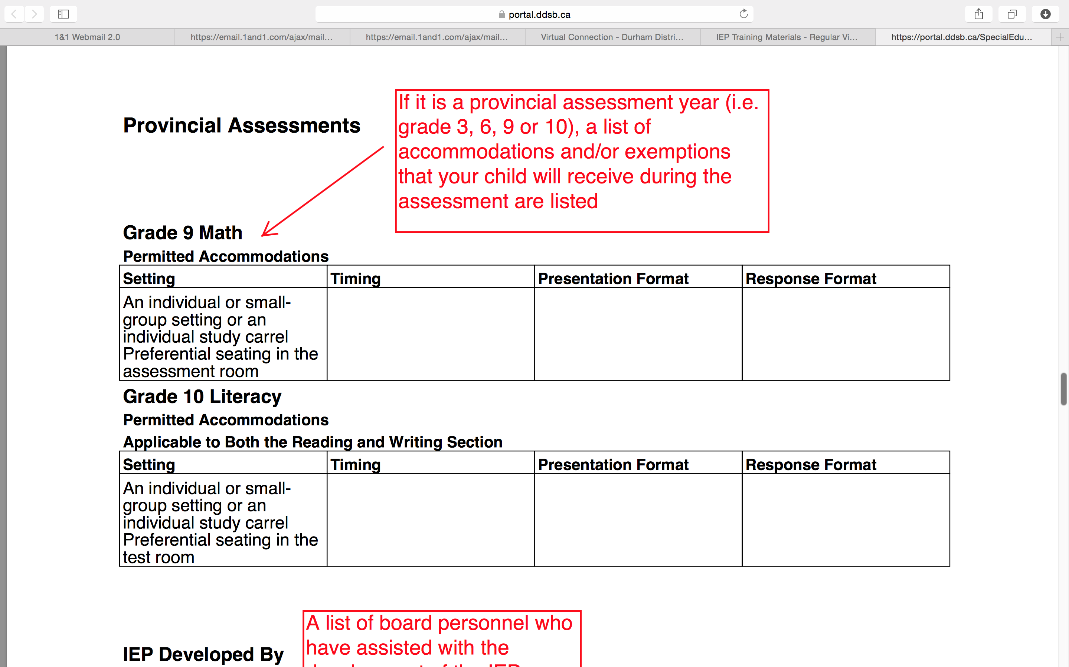

Slide 15
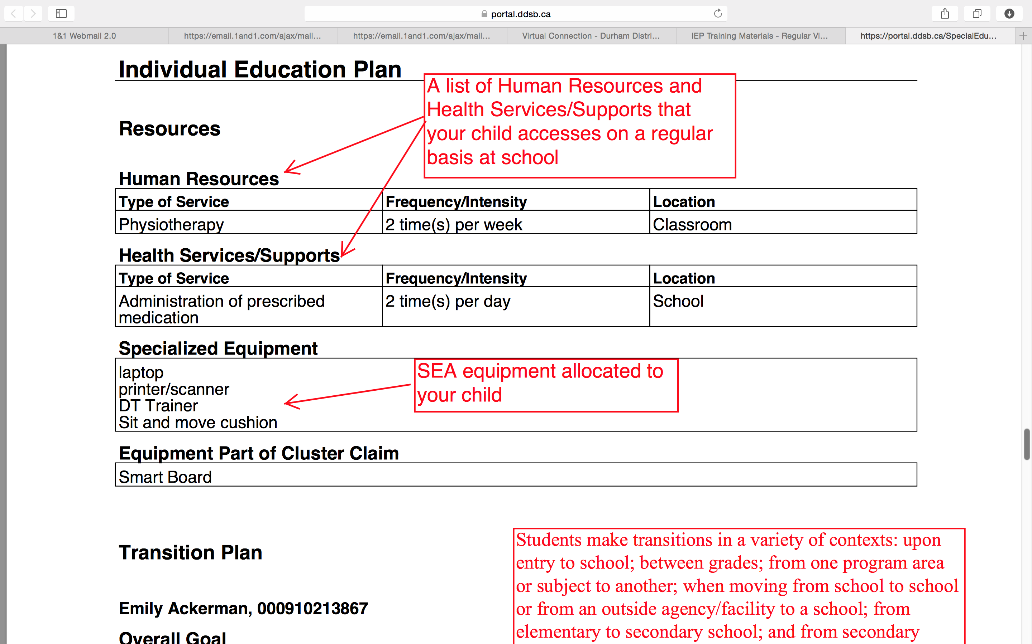
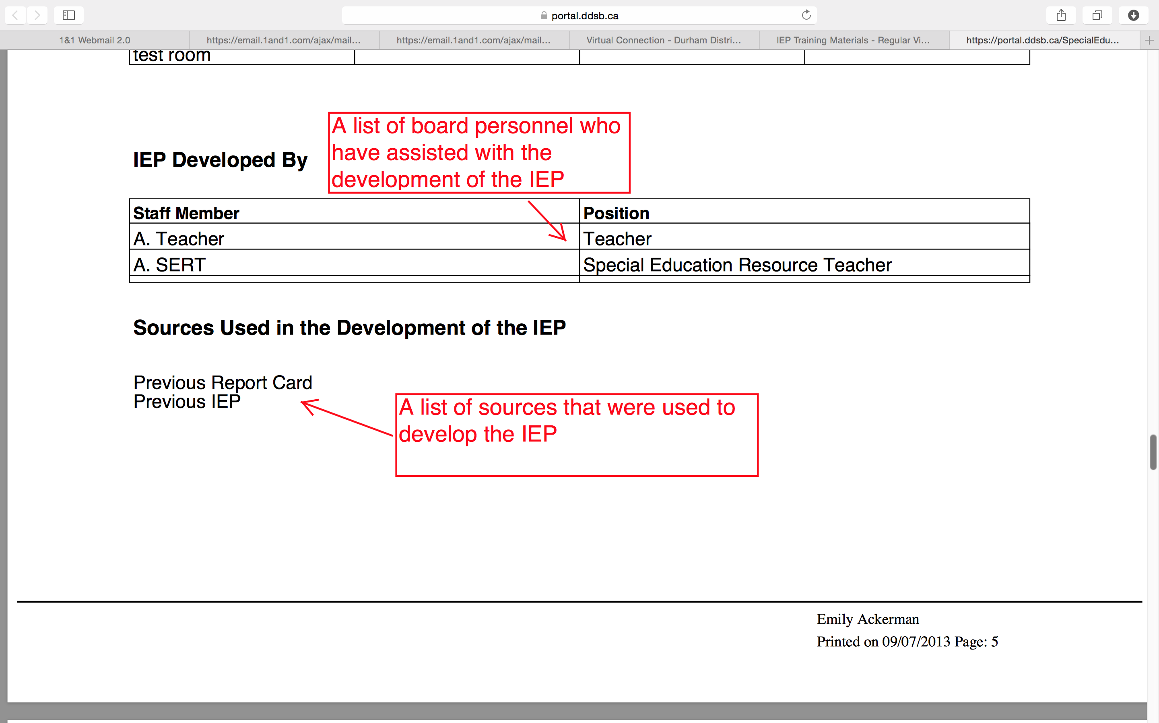

Slide 16
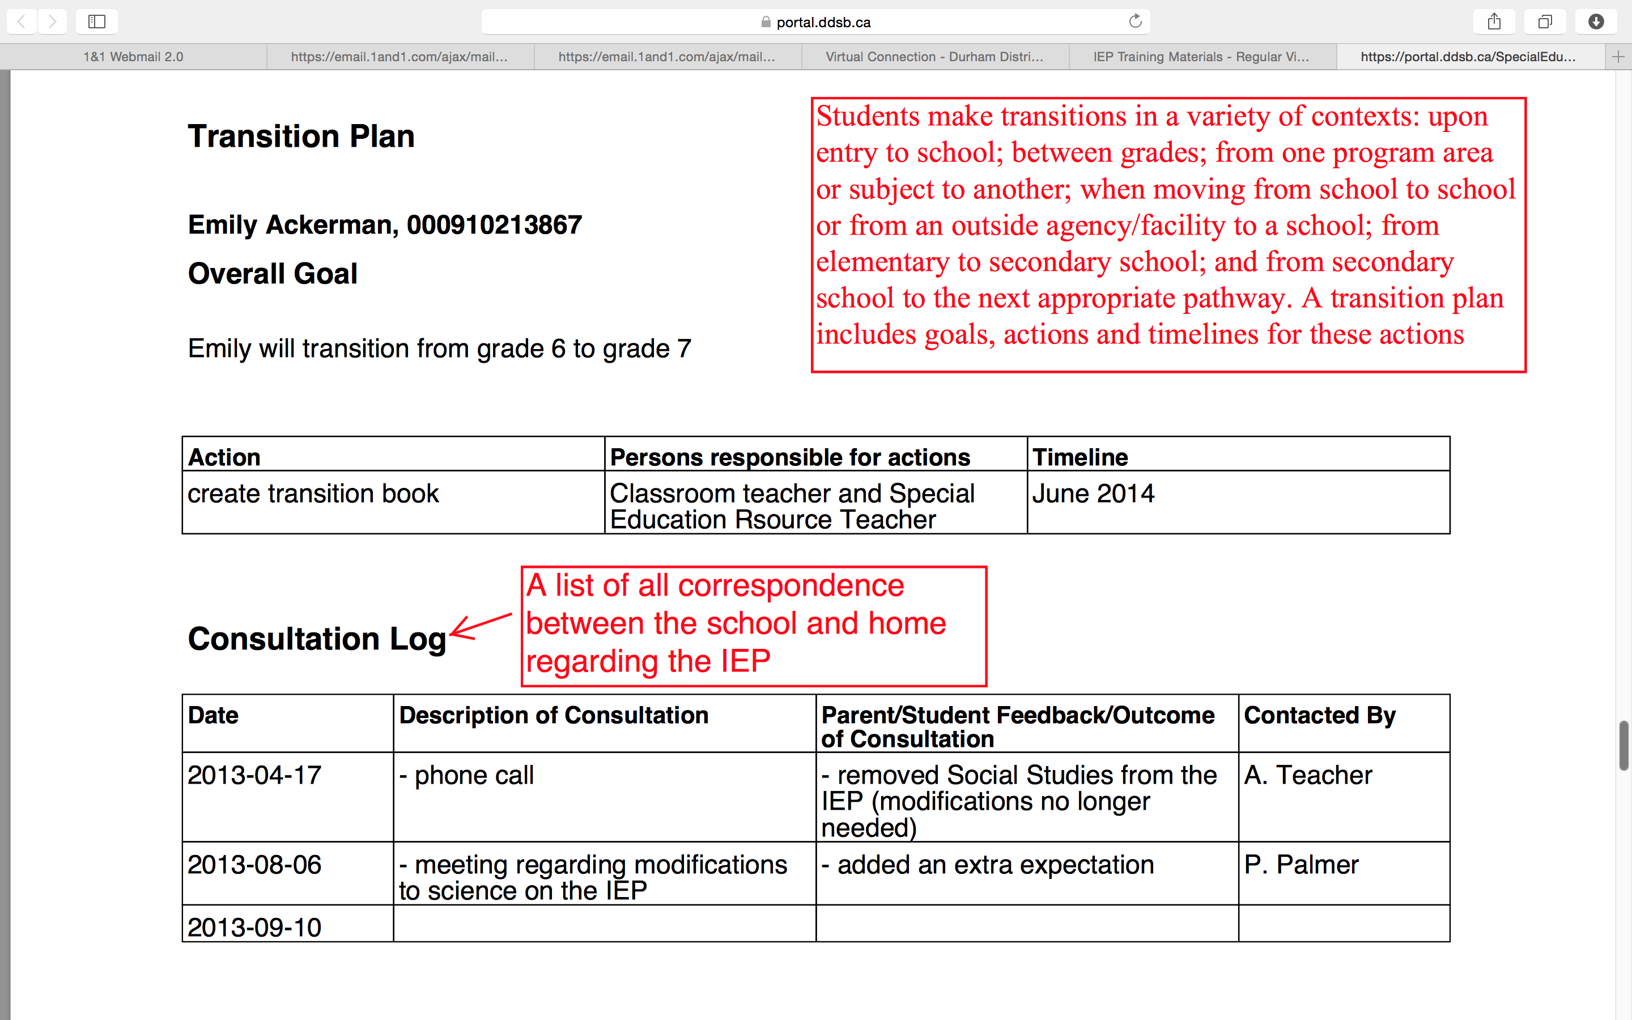
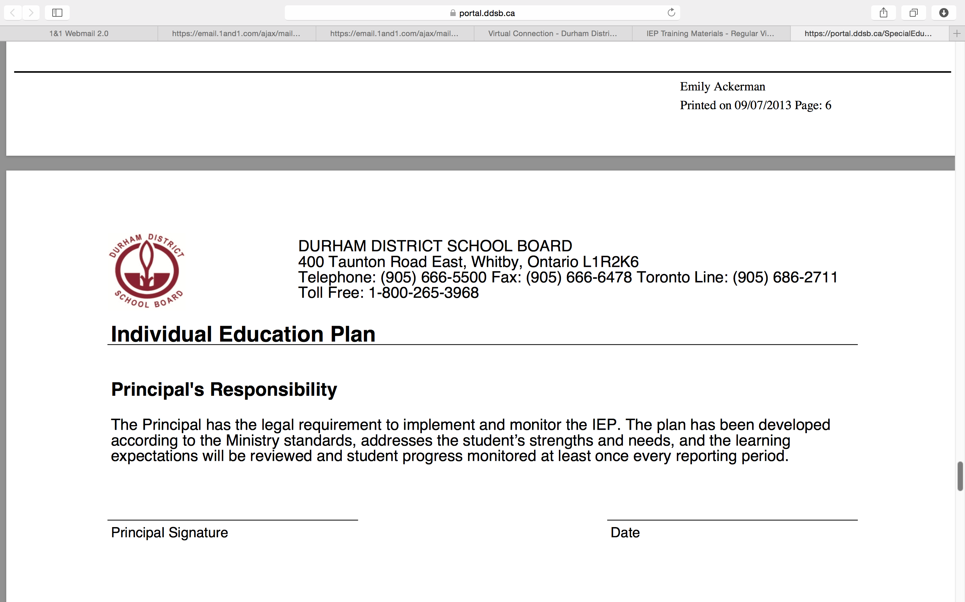

Slide 17
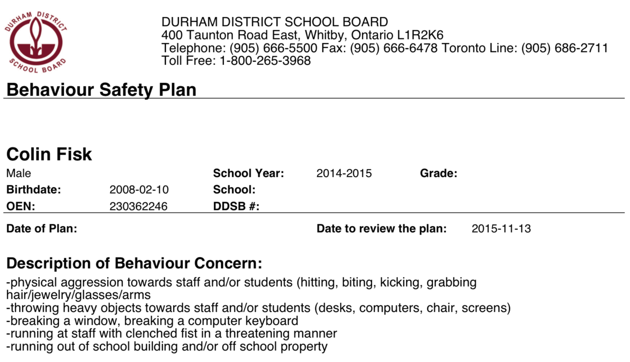
Behaviour Safety Plan (BSP)
Plan should be reviewed frequently and developed in consultation with Psychological Services support staff
Point form notes of behaviour concern(s). Behaviours indicate safety concerns not just inappropriate behaviours.

Slide 18
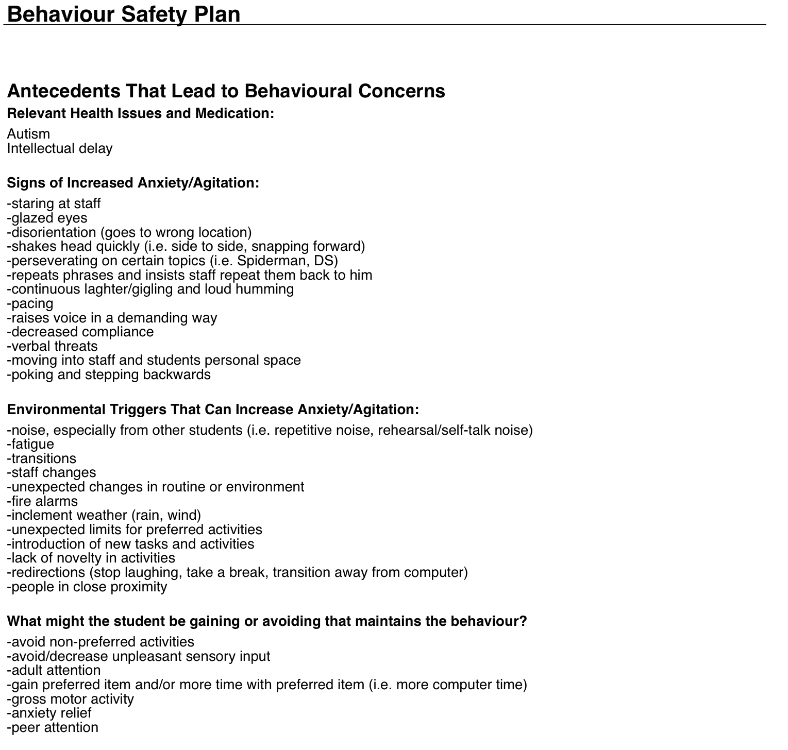
Description of relevant health and medical information that may affect behaviour.
Description of behaviour(s) that may occur when the student is getting agitated (in order of occurrence).
\
List of environmental or human interactions that may increase anxiety/agitation or anger response.
List of items that maintain the behaviour (ie. What is motivating for the student? What is motivating the behaviour to continue? What is the student getting or avoiding?

Slide 19
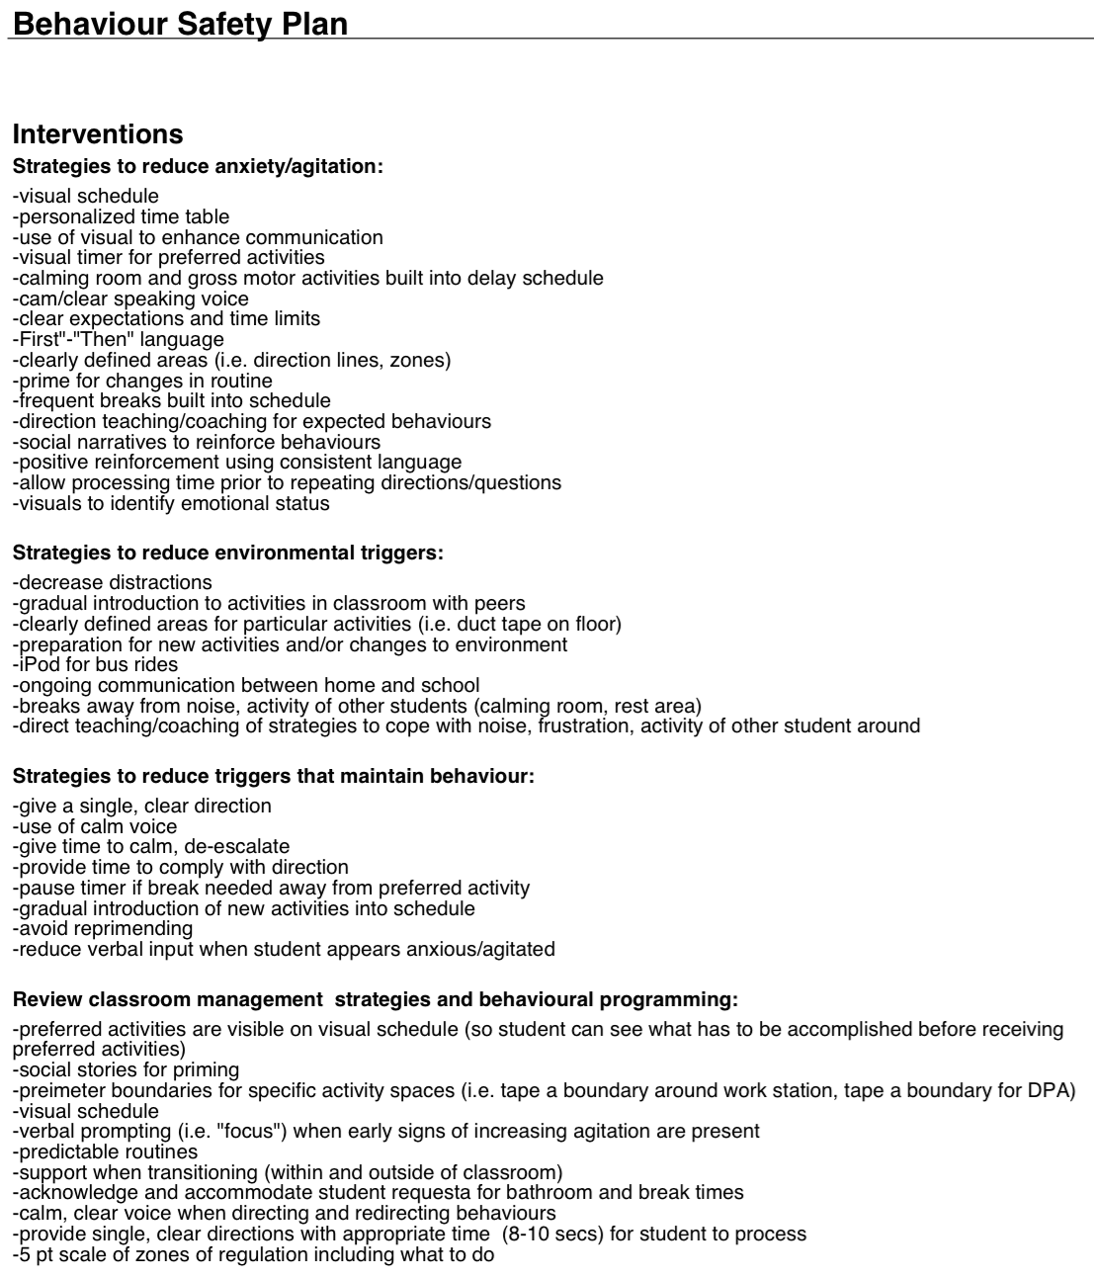
List of interventions/strategies that assist to de-escalate the student. These should be linked to signs of anxiety/agitation.
List of strategies that can be put in place to the physical and human environment to de-escalate the student. These should be linked to environmental triggers.
\
Strategies that reduce the likelihood of behaviours reoccurring. These should be linked to functions of behaviour.
Strategies that can be used in the classroom to de-escalate the student.

Slide 20
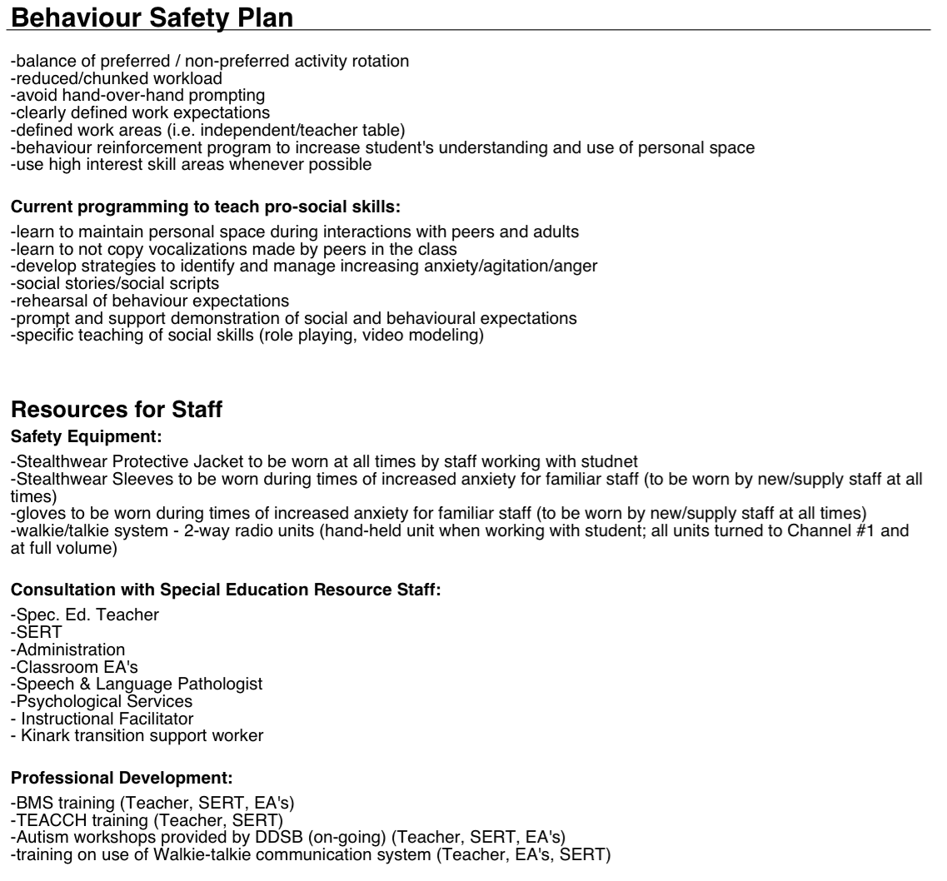
Programming suggestions that should incorporate high interest skill areas
Programming suggestions that assist with teaching the skills necessary for self-regulation.
\
Resources/Protective Equipment for staff to assist with safety and de-escalation of behaviours.

Slide 21
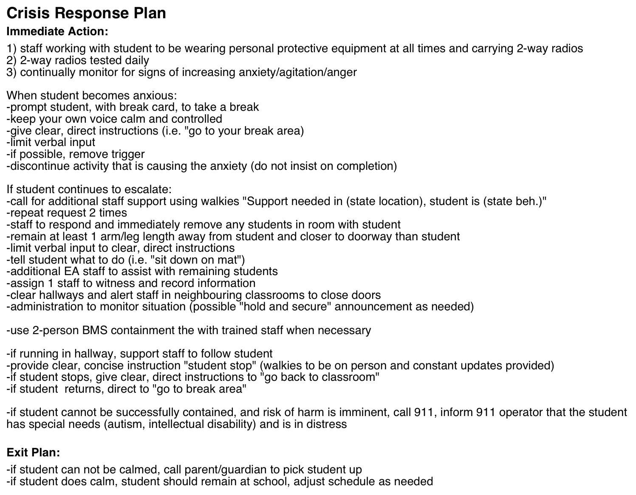
Plan to ensure the safety of all students and staff if the student’s unsafe behaviour escalates.
\

Slide 22
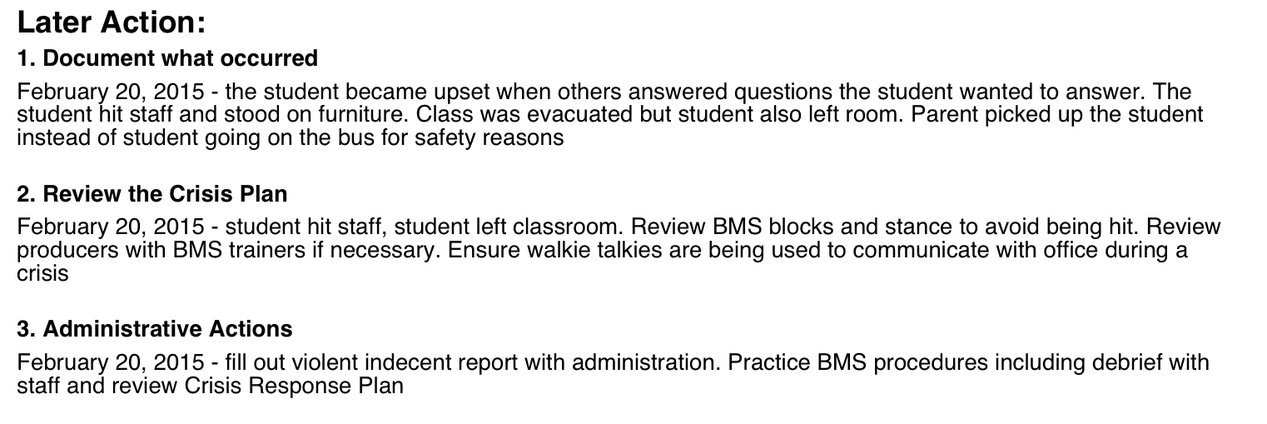
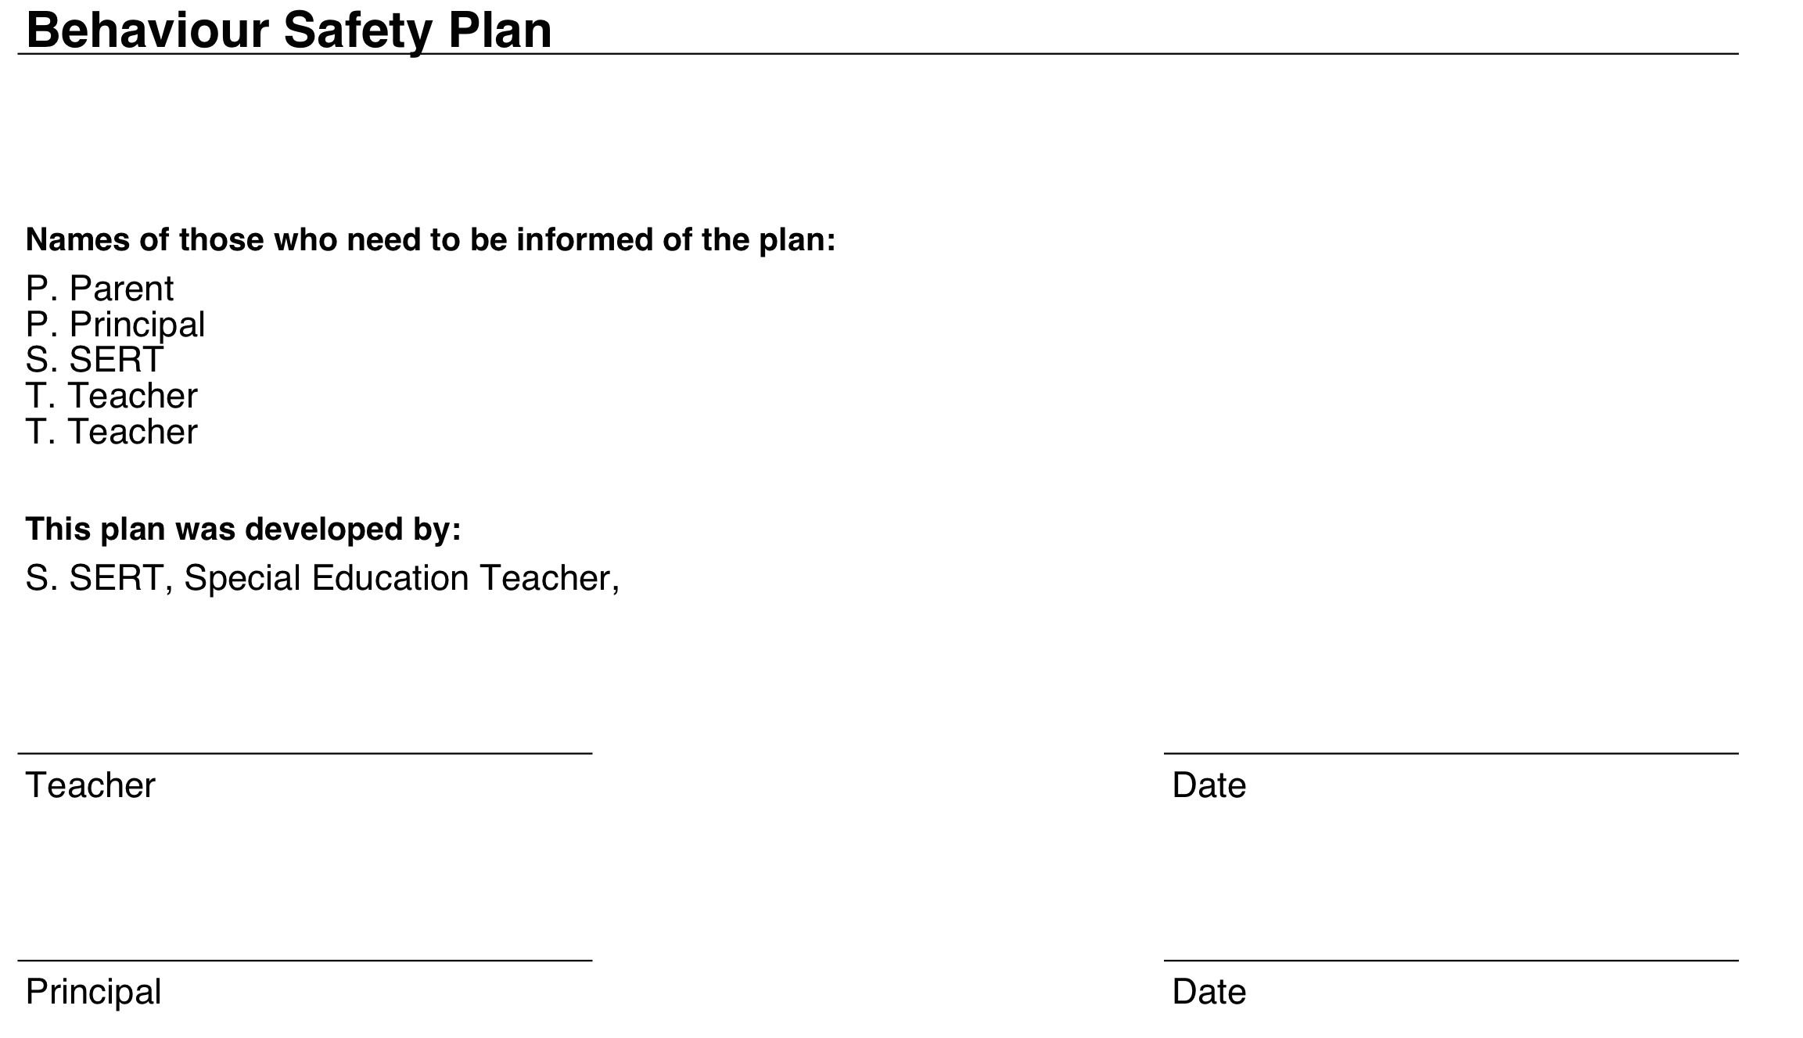
\

Slide 23
What is an IPRC?
An Identification, Placement and Review Committee (IPRC) is comprised of at least 3 people, usually a school principal or a supervisory officer of the school board, a special education resource teacher (SERT) and/or the student’s classroom teacher.
The role of the IPRC is to:
decide whether or not a student should be identified as exceptional
to identify this exceptionality
to decide on an appropriate placement for the student
to review the identification and placement at least once in each school year
If a parent believes his/her child will benefit from special education programs and/or services as described in an IEP and the school board does not agree, the parent has the right to request that an IPRC meet to determine if their child is an exceptional student.
Parents, and students of age 16 or older, or a representative of the parent or student may be present at and participate in all committee discussions about the student. An interpreter may also attend to speak on their behalf or provide support if required.

Slide 24
What decisions can an IPRC make?
The Identification, Placement and Review Committee (I.P.R.C.) can:
decide if a student is “exceptional”, and if so designates the area of exceptionality as defined by the Ministry of Education and Training
examine placement options based on the student’s needs and strengths where the IPRC has identified the student as exceptional
decide on one of five placement options defined by the Ministry of Education as outlined:
a regular class with indirect support
a regular class with resource assistance
a regular class with withdrawal assistance
a special education class with partial integration
a special education class full time
list the reasons for that choice if placement will be in a self-contained class may recommend specific programs or services.

Slide 25
DDSB, DCDSB, KPRDSB & P VNCCDSB Special Education Placement Options
Durham District School Board
Associated Class
Behaviour Assessment Class (BAC)
Behaviour Intervention Class (BIC)
Deaf/Hard of Hearing Class
Developmental Class
Gifted Class
Language Class
Learning Strategies Class (LSC)
Modified Class
Multiple Exceptionalities Class (ME)
Practical Learning Program (PLP)
Resource Room
Structured Learning Class (SLC)
Durham Catholic District School Board
Supervised Alternative Learning (S.A.L.)
Gifted Program
Kawartha Pine Ridge District School Board
Learning and Life Skills (L.L.S.)
Congregated Gifted Program
Peterborough, Victoria, Northumberland, Clarington Catholic District Board
Behaviour Education Support Training
Centre for Autism Spectrum Assistance
Learning for Living (Secondary)
Gifted Program

Slide 26
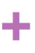
Special Education Path to I.P.R.C
STEP 1:
Teacher assesses strengths and needs of student:
recognizes a special need;
notifies parent/guardian, principal and SERT;
accommodates program to meet student needs;
evaluates effectiveness of changes.
STEP 2:
If student responds well to accommodations:
continue with selected strategies;
monitor progress;
teacher may implement IEP with list of accommodations being implemented.
If student is still experiencing difficulty:
meet with parents and SERT;
discuss concerns;
obtain parental consent for school-based assessment
develop plan involving accommodation(s) and develop a home-support plan;
implement new ideas and evaluate.
The Special Education Resource Teacher (SERT) also:
will observe the student and collect data pertaining to strengths and needs;
will create a plan of action, based on the recommendations and set a date to evaluate progress;
may provide and coordinate more direct support to the teacher and student through a variety of approaches.

Slide 27
STEP 3:
If student responds well to additional accommodations:
continue with current accommodations and strategies;
document all variations and evaluate;
maintain on-going assessment and evaluation.
If student is still experiencing difficulty:
present student update to in-school team;
begin profile documentation.
Student profile is started. Other written documentation is gathered.
STEP 4:
In-School Team:
teacher and SERT summarize classroom observations and/or assessment results to in-school team and outline current accommodations;
team brainstorms ideas/suggestions;
team collaboratively updates Action Plan.
STEP 5:
STEP 6:
Inform Parents/Guardians:
SERT and teacher discuss program accommodations with parent/guardians.
continue updated action plan and evaluate program accommodations.

Slide 28
STEP 7:
If student responds to further accommodations:
keep parent informed;
document success of the recommendations with Action Plan.
If student continues experiencing difficulty:
assess implemented accommodations;
develop further revisions/changes;
set a time line and schedule next meeting.
STEP 8:
STEP 9:
pre-referral consultation occurs with the Family of Schools Special Education Team to determine appropriate services. No identifying information is shared at this point.
If student responds to continued accommodations:
record accommodations for further reference;
continue with ongoing assessment and evaluation;
Continue to involve school resource personnel as needed.
If student continues experiencing difficulty:
discuss with parents possible special education support services (referral form);
obtain signed consent for services.
STEPS 1-8 must precede the
consent for services.
STEP 10:
Consent form submitted to Special Education Support Staff:
SERT verifies that appropriate forms and documentation are compiled and sent to Special Education support staff.

Slide 29
STEP 11:
Informed Consent:
Special Education support staff provide communication to parent/guardian to secure informed consent.
Special Education support staff ensure that parent/guardian is aware of the nature of services to be provided, appropriate time lines and confidentiality.
Support From Special Education Services
Special Education support staff may visit classrooms, observe and provide further assessment, program accommodation, strategies and materials as required (SERT informs teacher and administration as well).
Special Education support staff involvement may be consultative and/or involve direct student support.
If student responds to new accommodations/materials:
document changes to program;
report card reflects progress;
ongoing assessment and evaluation;
continue information sharing with parents/guardians and school/Special Education staff
If student continues experiencing difficulty:
proceed to Step 12.
STEP 12:
STEP 13:
SERT in consultation with Special Education Support Staff, coordinates case conference prior to I.P.R.C:
Special Education Parent Guide provided to Parent/Guardian
Parent/Guardian, teacher, EA, SERT, Administrator attend meeting.
If additional support is implemented:
no I.P.R.C.
If following the Case Conference (Step 12) all parties agree:
hold initial I.P.R.C.

Slide 30
STEP 14:
Ongoing monitoring and development of the IEP (if not yet implemented) by school staff, in conjunction with parents/guardians /community and relevant support staff.
All students brought to and IPRC are identified using the Ministry Categories of Exceptionalities.
These include:
Behaviour;
Communication (autism, deaf and hard of hearing, language impairment, speech impairment, learning disability);
Intellectual (giftedness, mild intellectual disability, developmental disability, intellectual disability);
Physical (physical disability, blind and low vision); and
Multiple (multiple exceptionalities).

Slide 31
What Happens After an IPRC?
You will receive a written statement of the IRPC’s decision. You will be asked to sign this document to indicate that you agree with the IPRC’s decisions and recommendations.
You may be asked to sign the written statement at the time of the IPRC, however, you have 30 days to return the signed document to the IRPC.
If you disagree with the IPRC’s decision, you have 15 school days to request a second meeting of the IPRC and 30 days to file a notice of appeal.
If after the second meeting you are still dissatisfied, you have 15 school days from the second decision to file an appeal.
The request for an appeal must be made in writing to the secretary of the board.
You must indicate the decision(s) with which you disagree and your reasons for disagreeing with those decisions.
If you do not request a second meeting or file an appeal, the decision of the IPRC will automatically be implemented after 30 school days.
A parent may request a review IPRC any time after their child has been in a special education program for 3 months.

Slide 32
IPRC and the Education Act
Before the IPRC considers placement of the student in a special education class, Regulation 181/98 requires it to consider placement in a regular class with appropriate special education services.
The Education Act in Ontario requires that school boards provide, or purchase from another school, special education programs and services for “exceptional” students.
All students formally identified as exceptional by an IPRC must have access to an education that will enable them to develop the knowledge and skills they need in order to participate in the life of Ontario's communities.
Specific procedures for the identification and placement of exceptional pupils are set out in Regulation 181/98 of the Education Act. This regulation also provides for the regular review of the identification and placement of a student and for the appeal of identification and/or placement decisions with which parents/guardians disagree.
In accordance with the Education Act, it is the responsibility of the school to annually review the identification and placement of each identified student. This annual review may occur in two possible formats:
1) Review IPRC Meeting 2) Annual Review Conference

Slide 33

With the proper supports, all children will learn and grow.

Slide 34
“I took what nature gave me, and I nurtured the heck out of it.”
-Dr. Temple Grandin

